Slide 1
Final Project
CS 5392 Summer I 2020
By
Morgan Langlais
Sri Naga Vindu Goluguri
Alka Raghav
Vinay Lokesh
CTL Model Checker

Slide 2
OBJECTIVE
Develop a Java standalone application that implements a model checking analysis tool for verification of properties defined in the CTL temporal logic. An application should be able to take as input the name of a file that contains definition of the Kripke structure to be analyzed, a state ID for which the property should be checked and a CTL formula that defines the property. The output should notify the user if the property is held or fails in the given state.
Input: model declaration, desired state, and CTL formula
Output: the model holds or the model does not hold

Slide 3
KRIPKE MODELS

Slide 4
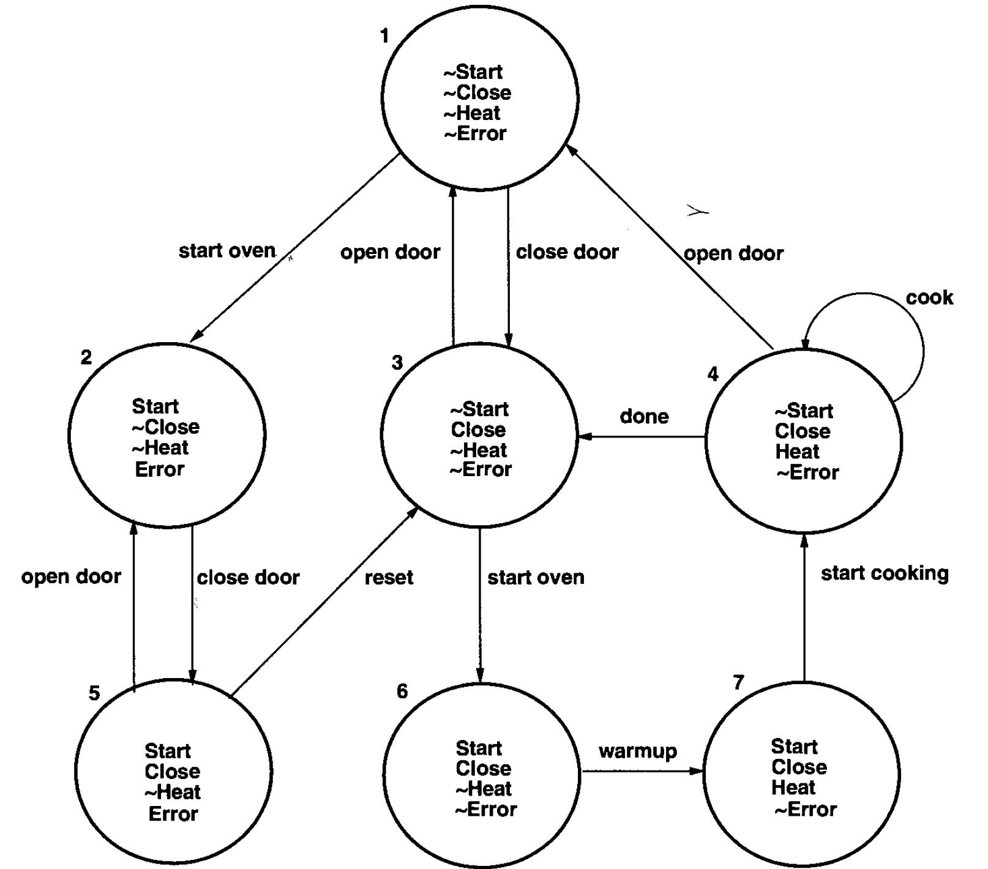
Microwave Model
States: s1, s2, s3, s4, s5, s6, s7;
Transitions: t1 : s1 - s2,
t2 : s1 - s3,
t3 : s3 - s1,
t4 : s4 - s1,
t5 : s4 - s4,
t6 : s4 - s3,
t7 : s2 - s5,
t8 : s5 - s2,
t9 : s5 - s3,
t10 : s3 - s6,
t11 : s6 - s7,
t12 : s7 - s4;
State Values: s1 : ,
s2 : s e,
s3 : c,
s4 : c h,
s5 : s c e,
s6 : s c,
s7 : s c h;

Slide 5
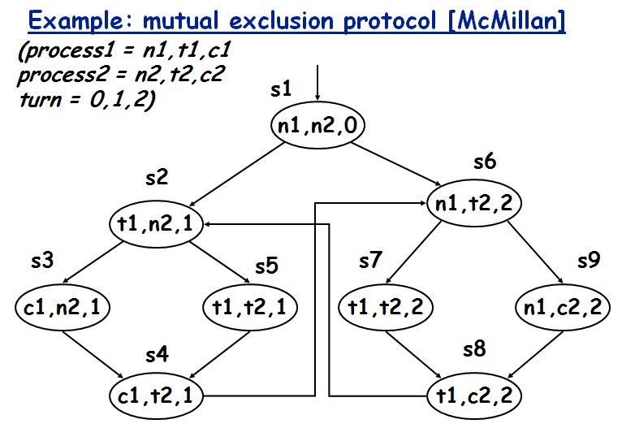
Model 4
States: s1, s2, s3, s4, s5, s6, s7,s8,s9;
Transitions: t1 : s1 - s2,
t2 : s2 - s3,
t3 : s3 - s4,
t4 : s5 - s4,
t5 : s2 - s5,
t6 : s4 - s6,
t7 : s8 - s2,
t8 : s1 - s6,
t9 : s6 - s7,
t10 : s7 - s8,
t11 : s9 - s8,
t12 : s6 - s9;
State Values: s1 : n1 n2 0,
s2 : t1 n2 1,
s3 : c1 n2 1,
s4 : c1 t2 1,
s5 : t1 t2 1,
s6 : n1 t2 2,
s7 : t1 t2 2,
s8 : t1 c2 2,
s9 : n1 c2 2;

Slide 6
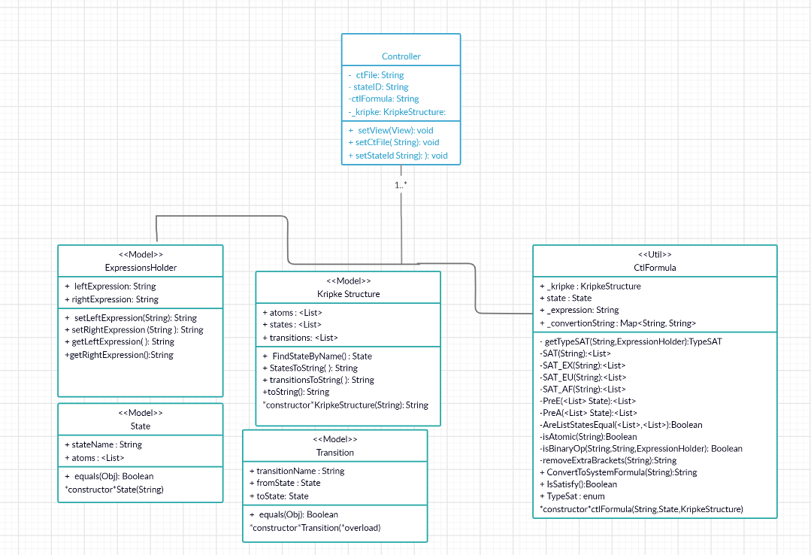
Class Diagram

Slide 7
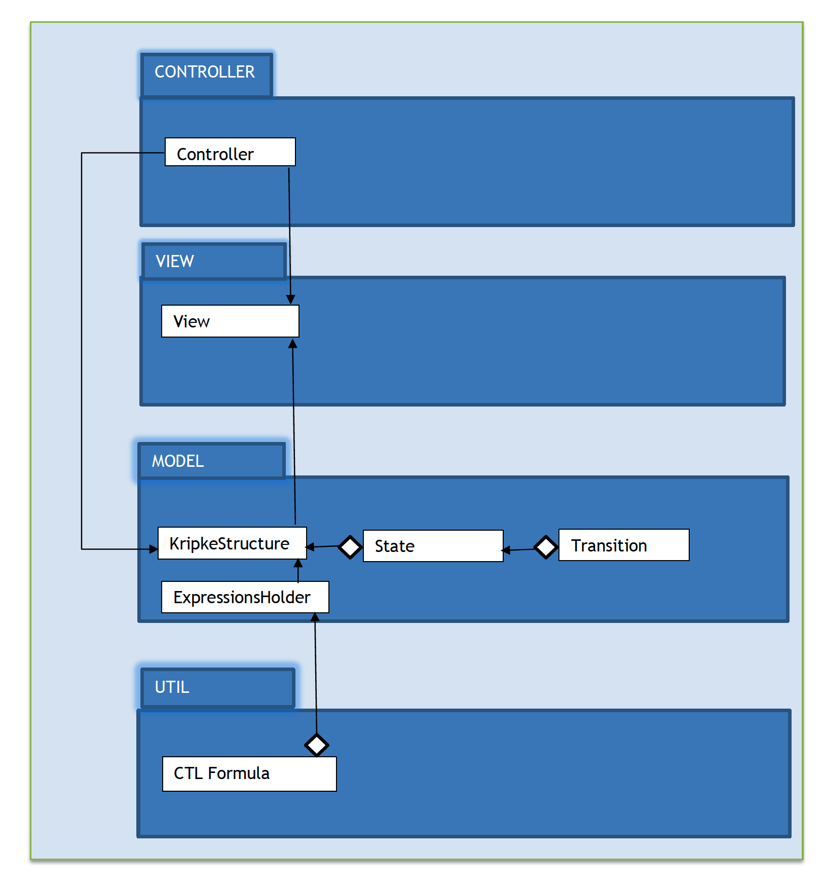
UML Diagram

Slide 8
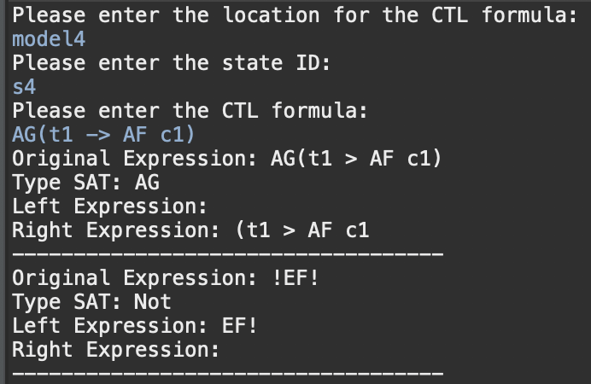
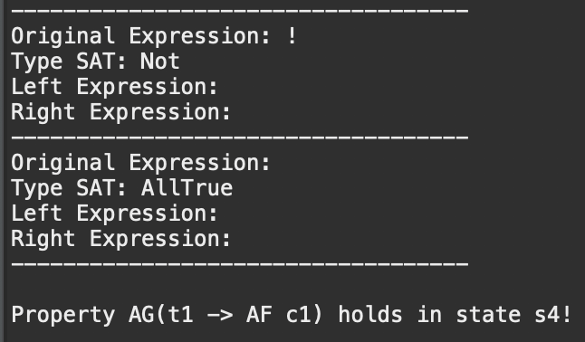
Model 4 Example
s4: AG(t1 -> AF c1)
...
...

Slide 9
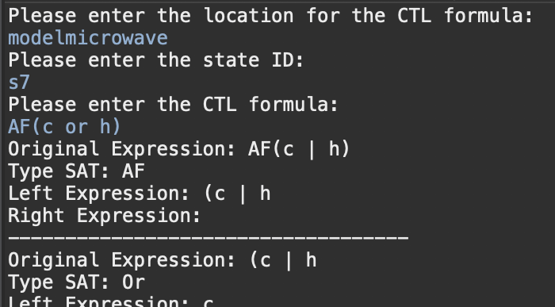
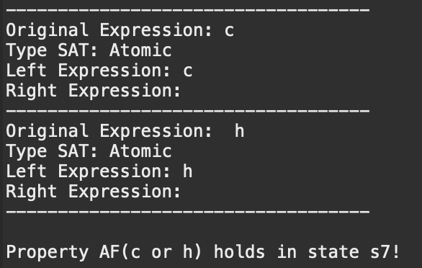
Microwave Example
s7: AF(c or h)
...
...

Slide 10
DEMO

Slide 11
THE
END

